Slide 1
ABSTRACT CLASS AND INTERFACES

Slide 2
Abstract class in Java A class which is declared with the abstract keyword is known as an abstract class in Java. It can have abstract and non-abstract methods (method with the body). Abstraction in Java Abstraction is a process of hiding the implementation details and showing only functionality to the user. Another way, it shows only essential things to the user and hides the internal details, For example, sending SMS where you type the text and send the message. You don't know the internal processing about the message delivery. Abstraction lets you focus on what the object does instead of how it does it. Ways to achieve AbstractionT here are two ways to achieve abstraction in java Abstract class (0 to 100%) Interface (100%) Abstract class in Java A class which is declared as abstract is known as an abstract class. It can have abstract and non-abstract methods. It needs to be extended and its method implemented. It cannot be instantiated. .

Slide 3
Points to Remember An abstract class must be declared with an abstract keyword. It can have abstract and non-abstract methods. It cannot be instantiated. It can have constructors and static methods also. It can have final methods which will force the subclass not to change the body of the method Example of abstract class abstract class A{} Abstract Method in Java A method which is declared as abstract and does not have implementation is known as an abstract method. Example of abstract method abstract void printStatus();//no method body and abstract

Slide 4
INTERFACES

Slide 5
What is an Interface? An interface is just like Java Class, but it only has static constants and abstract method. Java uses Interface to implement multiple inheritance. A Java class can implement multiple Java Interfaces. All methods in an interface are implicitly public and abstract. Syntax for Declaring Interface interface { //methods } To use an interface in your class, append the keyword "implements" after your class name followed by the interface name. Example for Implementing Interface class Dog implements Pet interface RidableAnimal extends Animal, Vehicle

Slide 6
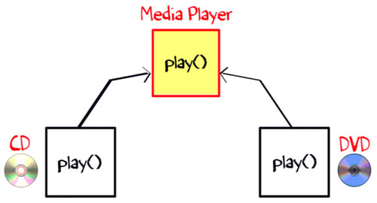
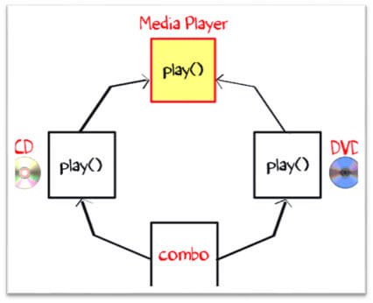
Why is an Interface required? To understand the concept of Java Interface better, let see an example. The class "Media Player" has two subclasses: CD player and DVD player. Each having its unique implementation method to play music. Another class "Combo drive" is inheriting both CD and DVD (see image below). Which play method should it inherit? This may cause serious design issues. And hence, Java does not allow multiple inheritance.

Slide 7
Difference between Class and Interface Class In class, you can instantiate variable and create an object. Class can contain concrete(with implementation) methods The access specifiers used with classes are private, protected and public. Interface In an interface, you can't instantiate variable and create an object. The interface cannot contain concrete(with implementation) methods In Interface only one specifier is used- Public.

Slide 8
Can we overload java main() method? Yes, by method overloading. You can have any number of main methods in a class by method overloading. But JVM calls main() method which receives string array as arguments only. Let's see the simple example: class TestOverloading4{ public static void main(String[] args){System.out.println("main with String[]");} public static void main(String args){System.out.println("main with String");} public static void main(){System.out.println("main without args");} }

Slide 9
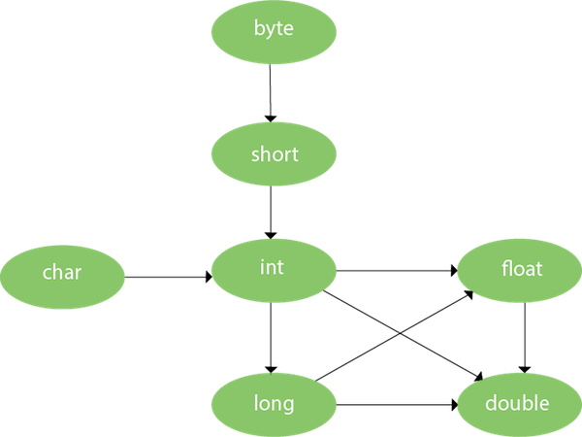
Method Overloading and Type Promotion One type is promoted to another implicitly if no matching datatype is found. Let's understand the concept by the figure given below: byte can be promoted to short, int, long, float or double. The short datatype can be promoted to int,long,float or double. The char datatype can be promoted to int,long,float or double and so on

Slide 10
Method Overloading in Java If a class has multiple methods having same name but different in parameters, it is known as Method Overloading. If we have to perform only one operation, having same name of the methods increases the readability of the program. Advantage of method overloading Method overloading increases the readability of the program. Different ways to overload the method There are two ways to overload the method in java By changing number of arguments By changing the data type

Slide 11
1)Method Overloading: changing no. of arguments class Adder { static int add(int a,int b){return a+b; } static int add(int a,int b,int c) { return a+b+c; } } class TestOverloading1 { public static void main(String[] args) { System.out.println(Adder.add(11,11)); System.out.println(Adder.add(11,11,11)); } }

Slide 12
2) Method Overloading: changing data type of arguments In this example, we have created two methods that differs in data type. The first add method receives two integer arguments and second add method receives two double arguments. class Adder { static int add(int a, int b) { return a+b; } static double add(double a, double b) { return a+b; } } class TestOverloading2 { public static void main(String[] args) { System.out.println(Adder.add(11,11)); System.out.println(Adder.add(12.3,12.6)); } }

Slide 13
Method Overriding in Java If subclass (child class) has the same method as declared in the parent class, it is known as method overriding in Java. In other words, If a subclass provides the specific implementation of the method that has been declared by one of its parent class, it is known as method overriding. Usage of Java Method Overriding Method overriding is used to provide the specific implementation of a method which is already provided by its superclass. Method overriding is used for runtime polymorphism Rules for Java Method Overriding The method must have the same name as in the parent class The method must have the same parameter as in the parent class. There must be an IS-A relationship (inheritance).

